Slide 1
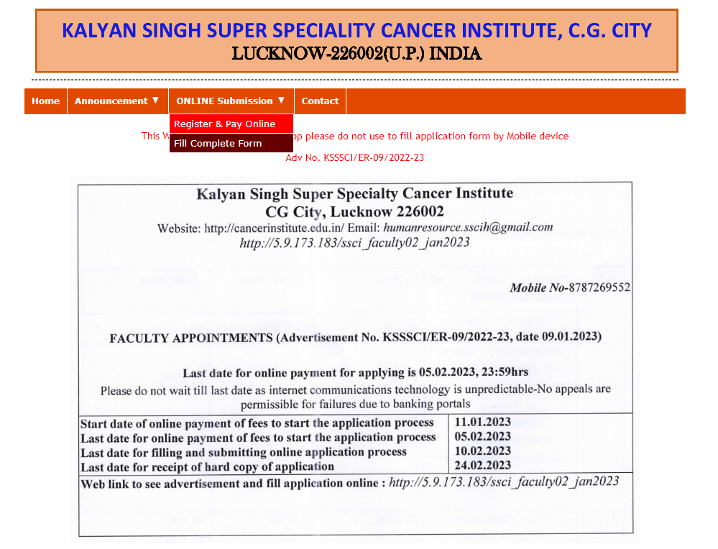
Payment Step -1

Slide 2
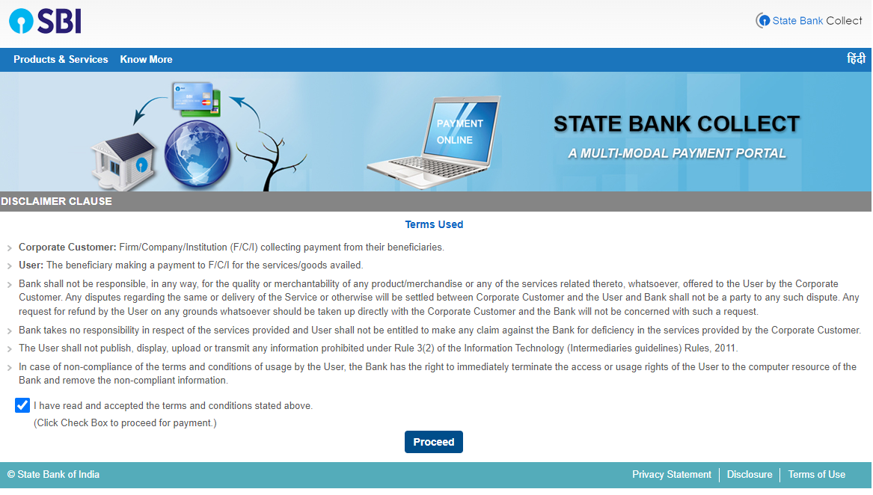
Payment Step -2

Slide 3
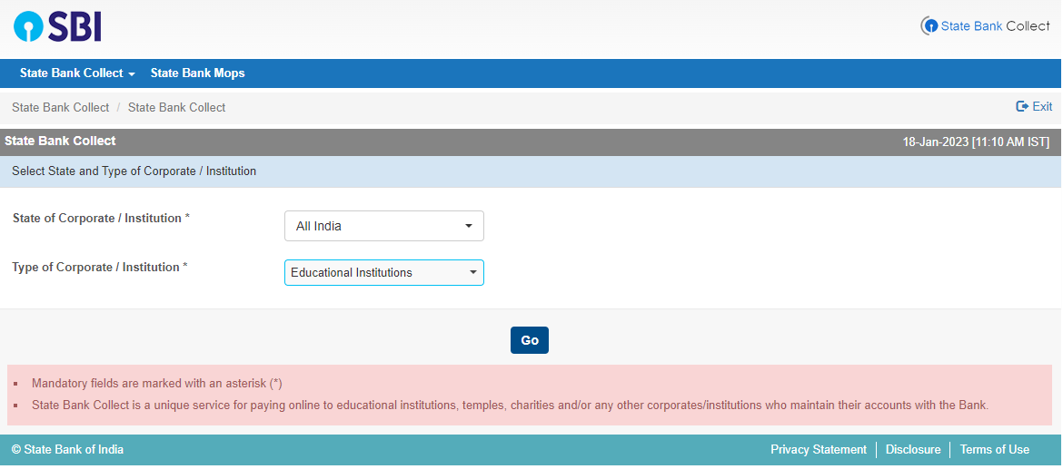
Payment Step -3

Slide 4
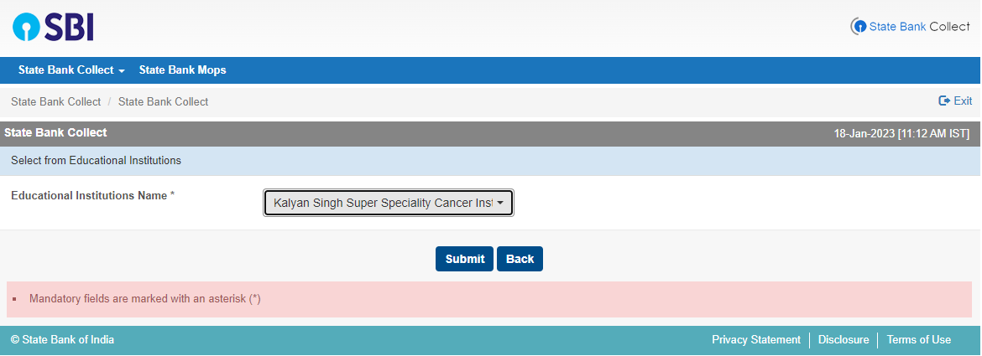
Payment Step -4

Slide 5
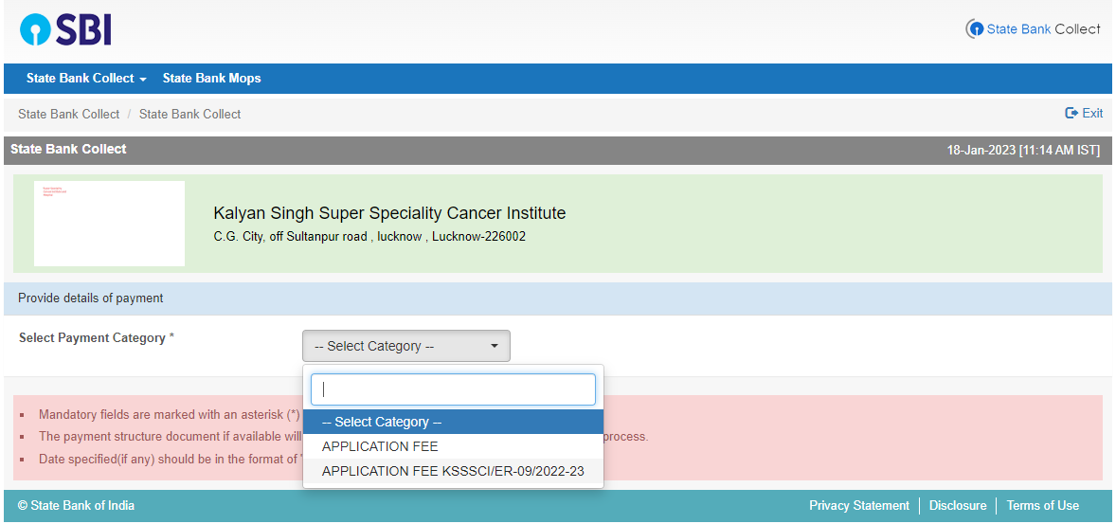
Payment Step -5
Click on it and go further

